Slide 1
Chapter 4: Logical Database Design and the Relational Model
Modern Database Management
12th Edition
Jeff Hoffer, Ramesh Venkataraman,
Heikki Topi

Slide 2
Objectives
Define terms
List five properties of relations
State two properties of candidate keys
Define first, second, and third normal form
Describe problems from merging relations
Transform E-R and EER diagrams to relations
Create tables with entity and relational integrity constraints
Use normalization to decompose anomalous relations to well-structured relations

Slide 3
Components of relational model
Data structure
Tables (relations), rows, columns
Data manipulation
Powerful SQL operations for retrieving and modifying data
Data integrity
Mechanisms for implementing business rules that maintain integrity of manipulated data

Slide 4
Relation
A relation is a named, two-dimensional table of data.
A table consists of rows (records) and columns (attribute or field).
Requirements for a table to qualify as a relation:
It must have a unique name.
Every attribute value must be atomic (not multivalued, not composite).
Every row must be unique (can’t have two rows with exactly the same values for all their fields).
Attributes (columns) in tables must have unique names.
The order of the columns must be irrelevant.
The order of the rows must be irrelevant.
NOTE: All relations are in 1st Normal form.
Notes:
All relations are tables, but not all tables are relations. Think of a “table” as simply being a grid with rows and columns. In this sense, a spreadsheet could be a “table”. To qualify as a relation, each row would need to be unique, which implies that each row needs to have a primary key.

Slide 5
Data Normalization
Primarily a tool to validate and improve a logical design so that it satisfies certain constraints that avoid unnecessary duplication of data
The process of decomposing relations with anomalies to produce smaller, well-structured relations
Notes:
The previous slides showed how to map an E-R model to a relational database design. If you follow these mappings, then your result will be a well-structured database. But if you just start by creating tables without considering the ER rules, then you will likely get a database that is not well-structured. These databases could cause anomalies because of data duplication. In the next several slides we’ll see how to correct these anomalies through a process called “normalization”.

Slide 6
Well-Structured Relations
A relation that contains minimal data redundancy and allows users to insert, delete, and update rows without causing data inconsistencies
Goal is to avoid anomalies
Insertion Anomaly–adding new rows forces user to create duplicate data
Deletion Anomaly–deleting rows may cause a loss of data that would be needed for other future rows
Modification Anomaly–changing data in a row forces changes to other rows because of duplication
General rule of thumb: A table should not pertain to more than one entity type.

Slide 7
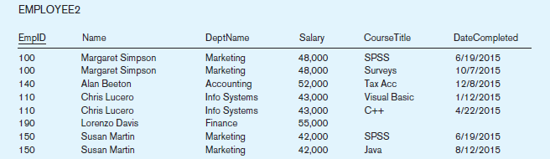
Example–Figure 4-2b
Question–Is this a relation?
Answer–Yes: Unique rows and no multivalued attributes
Question–What’s the primary key?
Answer–Composite: EmpID, CourseTitle
Notes:
This is a relation. But it is not a well-structured relation.

Slide 8
Anomalies in this Table
Insertion–can’t enter a new employee without having the employee take a class (or at least empty fields of class information)
Deletion–if we remove employee 140, we lose information about the existence of a Tax Acc class
Modification–giving a salary increase to employee 100 forces us to update multiple records
Why do these anomalies exist?
Because there are two themes (entity types) in this one relation. This results in data duplication and an unnecessary dependency between the entities.

Slide 9
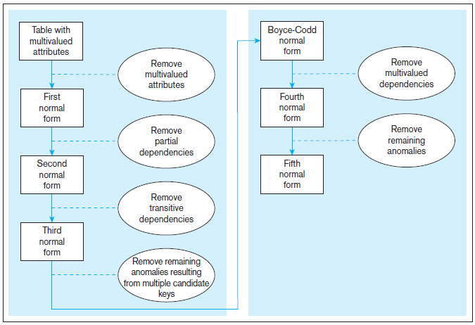
Figure 4.22 Steps in normalization
3rd normal form is generally considered sufficient
Notes:
It is important that a database reach third normal form. Boyce-Codd, fourth, and fifth are of theoretical interest, but not generally considered vital for qualifying as a set of well-structured relations.

Slide 10
Functional Dependencies and Keys
Functional Dependency: The value of one attribute (the determinant) determines the value of another attribute
Candidate Key:
A unique identifier. One of the candidate keys will become the primary key
E.g., perhaps there is both credit card number and SS# in a table…in this case both are candidate keys.
Each non-key field is functionally dependent on every candidate key.

Slide 11
First Normal Form
No multivalued attributes
Every attribute value is atomic
Fig. 4-25 is not in 1st Normal Form (multivalued attributes) ➔ it is not a relation.
Fig. 4-26 is in 1st Normal form.
All relations are in 1st Normal Form.

Slide 12
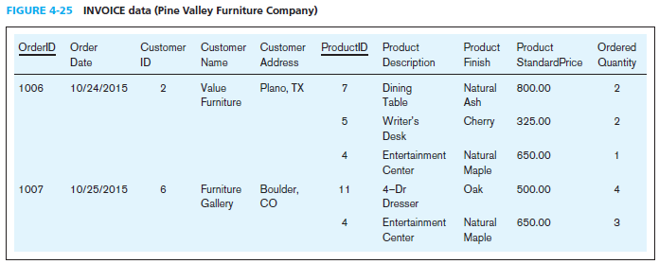
Table with multivalued attributes, not in 1st normal form
Note: This is NOT a relation.
Notes:
This table is not a relation. Note the blank OrderID field. Also, we don’t explicitly see the customer or order date for the second, third, and fifth rows. You can imagine seeing something like this in a spreadsheet and inferring that the second and third rows correspond with order 1006. But this is not sufficient for a database.
Basically, we here are violating the principle of “no multivalued attributes”. It’s as if OrderID 1006 has “ProductID” equaling 7, 5, and 4. You can’t have that in a true relation.

Slide 13
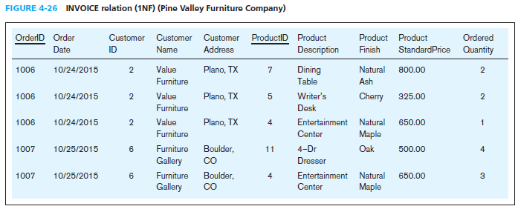
Table with no multivalued attributes and unique rows, in 1st normal form
Note: This is a relation, but not a well-structured one.
Notes:
Now we have a true relation. It is in first normal form. But note the data duplication. This will cause anomalies.

Slide 14
Anomalies in this Table
Insertion–if new product is ordered for order 1007 of existing customer, customer data must be re-entered, causing duplication
Deletion–if we delete the Dining Table from Order 1006, we lose information concerning this item’s finish and price
Update–changing the price of product ID 4 requires update in multiple records
Why do these anomalies exist?
Because there are multiple themes (entity types) in one relation. This results in duplication and an unnecessary dependency between the entities.

Slide 15
Second Normal Form
1NF PLUS every non-key attribute is fully functionally dependent on the ENTIRE primary key
Every non-key attribute must be defined by the entire key, not by only part of the key
No partial functional dependencies

Slide 16
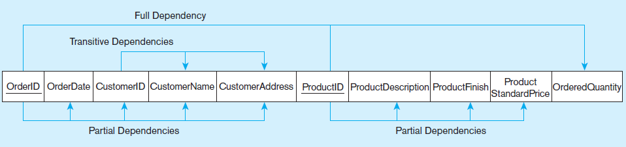
Figure 4-27 Functional dependency diagram for INVOICE
OrderID ➔ OrderDate, CustomerID, CustomerName, CustomerAddress
CustomerID ➔ CustomerName, CustomerAddress
ProductID ➔ ProductDescription, ProductFinish, ProductStandardPrice
OrderID, ProductID ➔ OrderQuantity
Therefore, NOT in 2nd Normal Form
Notes:
So, in this one relation, there are both partial and transitive dependencies. Because of partial dependencies, the relation is not in 2nd normal form. So, our first step is to remove the partial dependencies by splitting the table into three, one for orders, one for products, and one for order line.

Slide 17
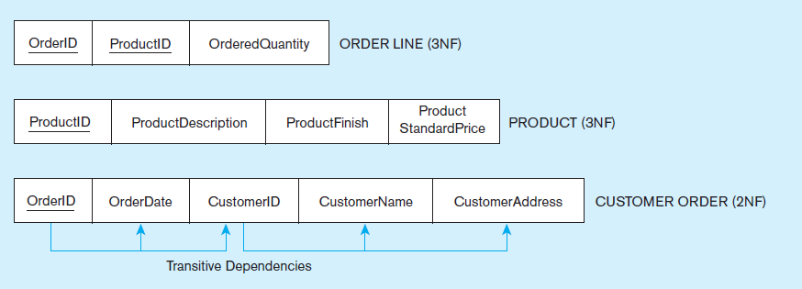
Figure 4-28 Removing partial dependencies
Getting it into Second Normal Form
Partial dependencies are removed, but there are still transitive dependencies
Notes:
So, now we have three separate relations. There is no partial dependency. But we still have a transitive dependency. We will fix this next by splitting customers from orders.

Slide 18
Third Normal Form
2NF PLUS no transitive dependencies (functional dependencies on non-primary-key attributes)
Note: This is called transitive, because the primary key is a determinant for another attribute, which in turn is a determinant for a third
Solution: Non-key determinant with transitive dependencies go into a new table; non-key determinant becomes primary key in the new table and stays as foreign key in the old table

Slide 19
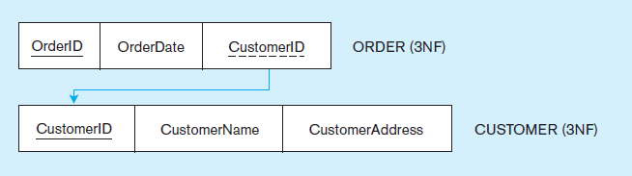
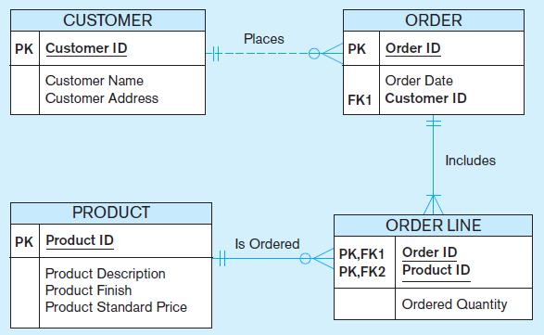
Figure 4-29 Removing partial dependencies
Getting it into Third Normal Form
Transitive dependencies are removed.
Figure 4-30 shows the result of normalization, yielding four separate relations where initially there was only one.
Notes:
Finally we are at third normal form. At this point we have a well-structured database.
Note that if we had started with a thorough ER model, we would not have wound up with one big table containing multiple themes. The original table basically had three separate entities all wrapped into a single relation (customer, product, and order). Furthermore, it hid the fact of a many-to-many relationship between orders and products.
This illustrates the danger of going straight to the logical database design without first performing the conceptual model analysis. But this sort of thing happens all to often.

Slide 20
Merging Relations
View Integration–Combining entities from multiple ER models into common relations
Issues to watch out for when merging entities from different ER models:
Synonyms–two or more attributes with different names but same meaning
Homonyms–attributes with same name but different meanings
Transitive dependencies–even if relations are in 3NF prior to merging, they may not be after merging
Supertype/subtype relationships–may be hidden prior to merging
Notes:
Most medium-to-large organizations have many reasonably independent systems development activities that at some point may need to come together to create a shared database. The result is that some of the relations generated from these various processes may be redundant. This is where view integration comes in handy. But you need to be cautious about the problems that stem from these redundancies.

Slide 21
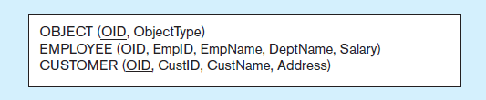
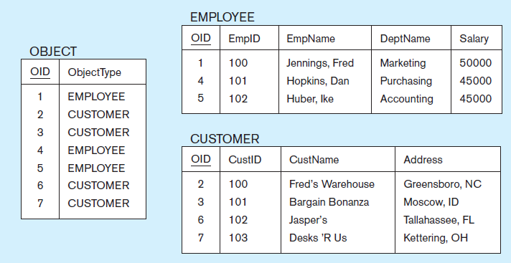
Figure 4-31 Enterprise keys
a) Relations with enterprise key
b) Sample data with enterprise key
Notes:
Enterprise keys are primary keys that are unique in the whole database, not just within a single relation. This corresponds with the concept of an object ID in object-oriented systems

Slide 22


